Slide 1
DEV, QA, and PROD Environments in IT Software Product Life Cycle
Paramatma Pulivarthi
Paramatma Pulivarthi

Slide 2
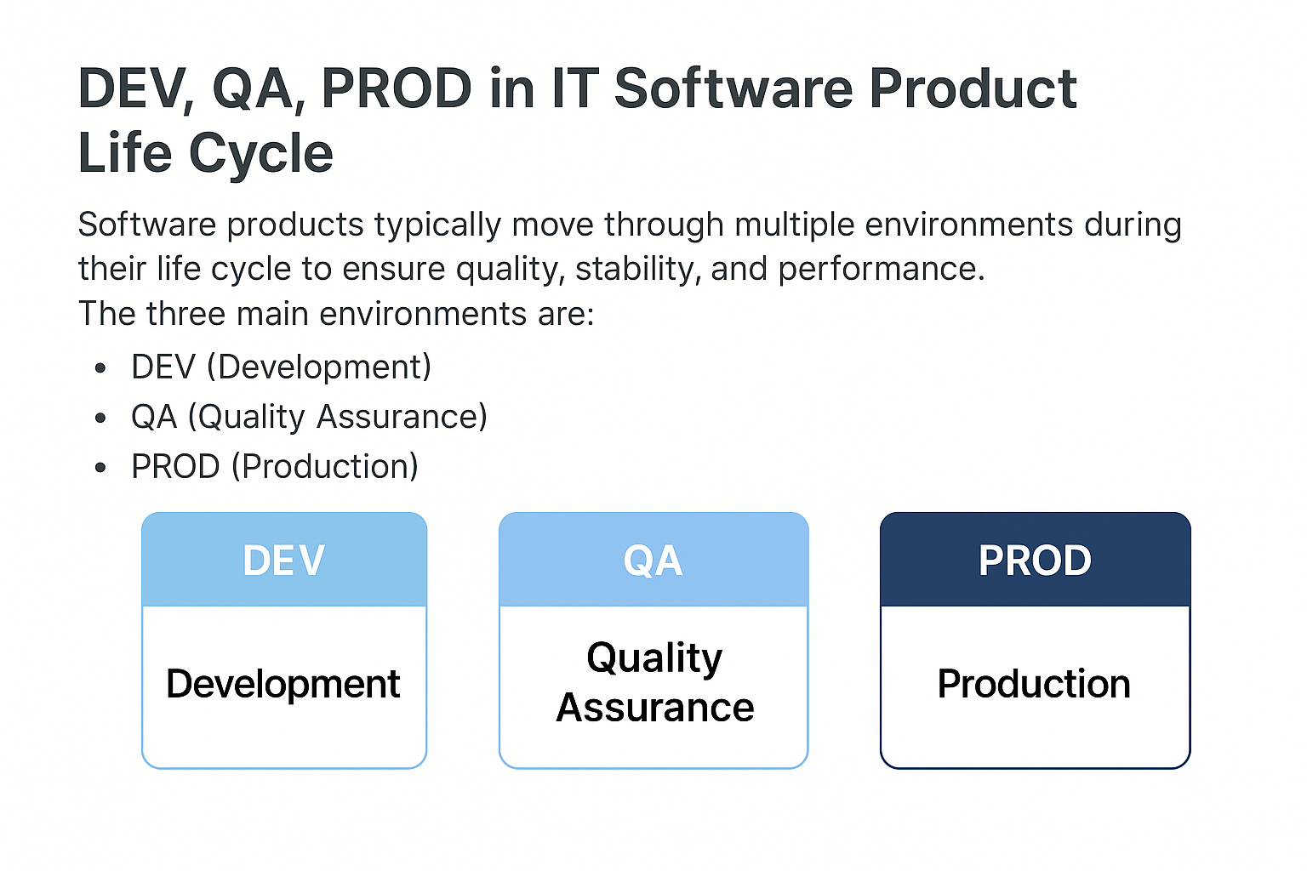

Slide 3
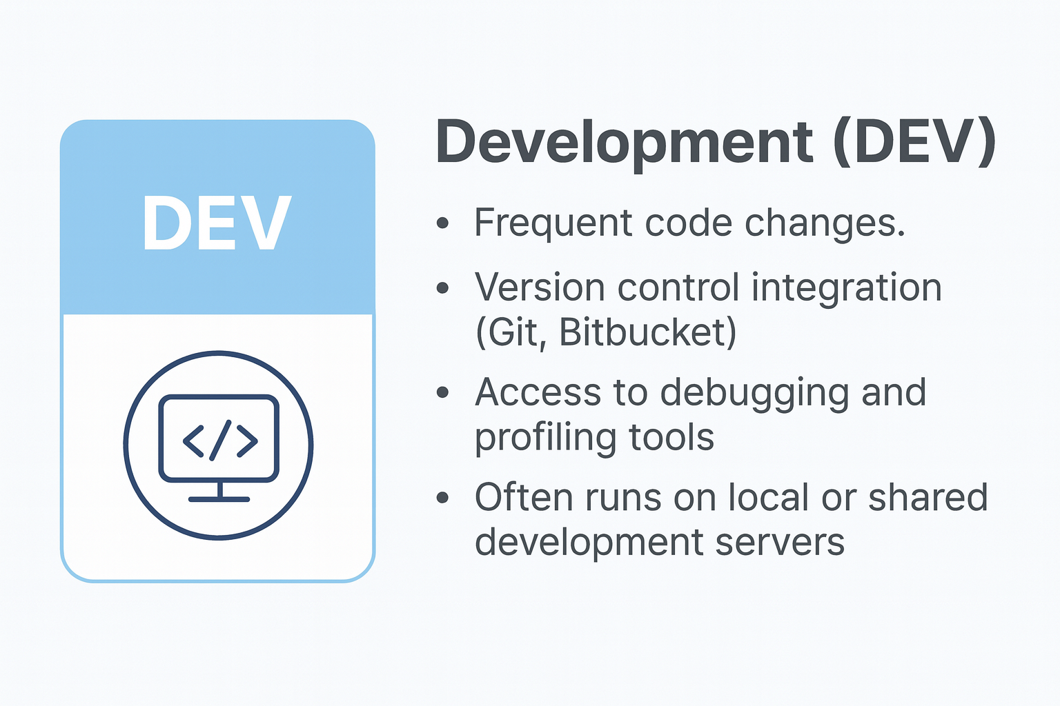
Development (DEV) Environment
The DEV environment is where developers build and integrate new features, fix bugs, and experiment with code.
Key Characteristics:
.
Goal: Enable rapid iteration and innovation while maintaining code quality.
Paramatma Pulivarthi

Slide 4


Slide 5
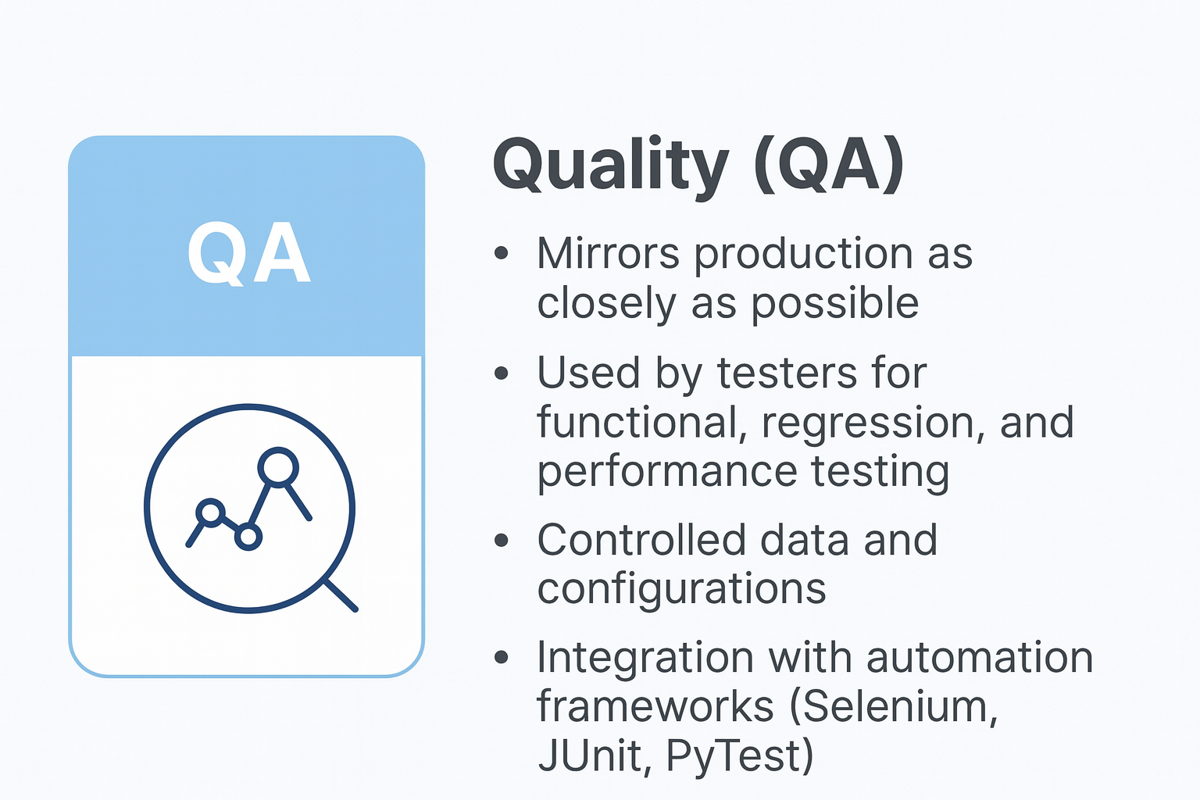
Quality Assurance (QA) Environment
The QA environment is dedicated to testing and validation of the software product before it goes live.
Key Characteristics:
Goal: Ensure all bugs are identified and fixed before deployment to production.
Paramatma Pulivarthi

Slide 6


Slide 7
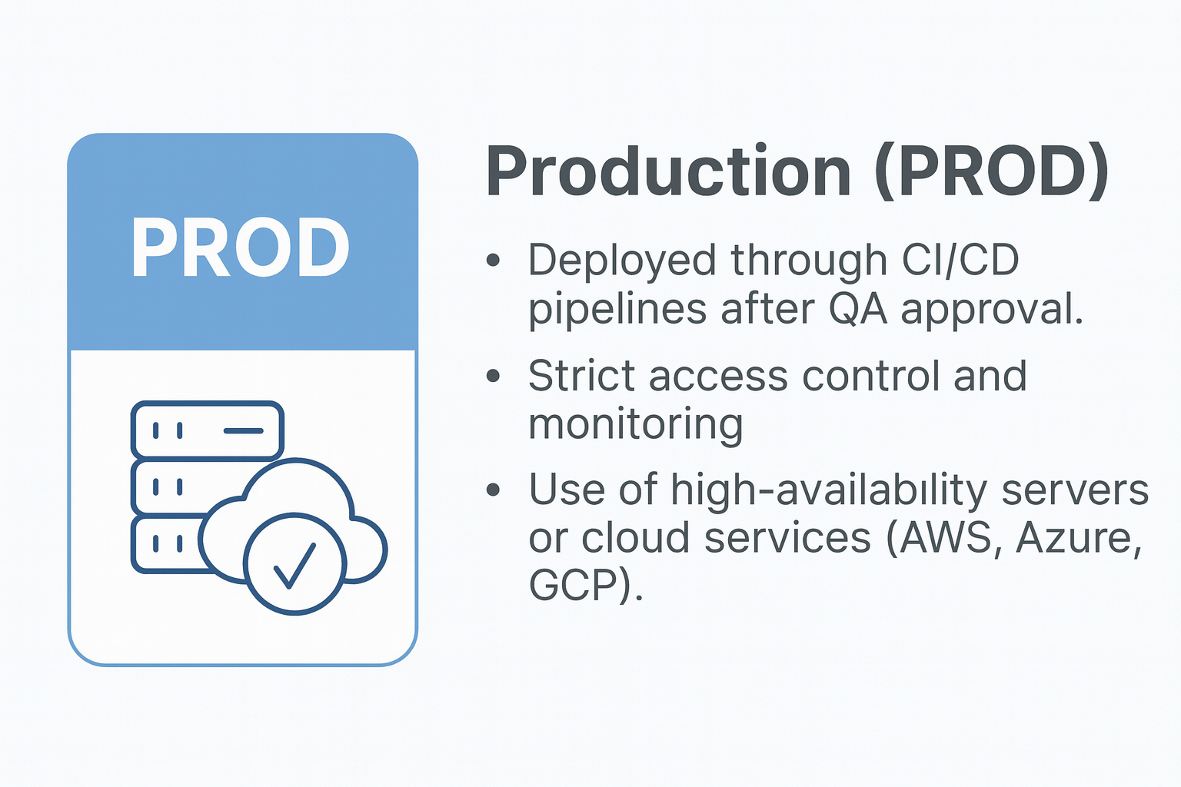
Production (PROD) Environment
The PROD environment hosts the live application used by end users. It must be secure, reliable, and highly available.
Key Characteristics:
Goal: Deliver a stable, high-performance experience to users.
Paramatma Pulivarthi

Slide 8
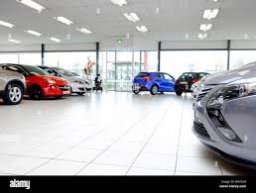
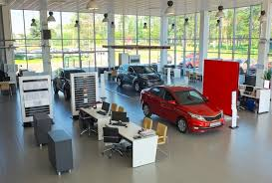

Slide 9
Flow Between Environments
DEV
QA
PROD
Paramatma Pulivarthi

Slide 10
Integration with Software Product Life Cycle
Each environment aligns with different stages of the software product life cycle:
• DEV → Supports Design and Development phases.
• QA → Validates during Testing and Pre-release.
• PROD → Operates during Deployment and Maintenance.
This structured environment flow ensures controlled delivery, quality assurance, and sustainable operations.
Paramatma Pulivarthi

